Slide 1
The Power of Persuasion in Parliamentary Debate
2016 SNFI
Parliamentary Debate
Keynote Lecture
Notes:
When you’re building a simple house, a modern sky-scraper or the Taj Mal, you always start first in exactly the same place. Where is that, what is the first step in building a sturdy & magnificent structure?
All building starts at the foundation. And guess what the foundation of parliamentary debate is? Yes…persuasion. Persuasion is the foundation of championship parliamentary debate, so that is where we’ll start building our skills.

Slide 2
What is Parliamentary Debate?
Motion
(Topic for debate)
Proposition Team
(For the topic)
Opposition Team
(Against the topic)
Judge
Notes:
How do you win a parliamentary debate?
Is there a scoreboard like football or basketball?
Who do you need to convince?
Are you trying to convince the other team?
Can you make the judge vote for you?
What is the secret to parliamentary debate?

Slide 3


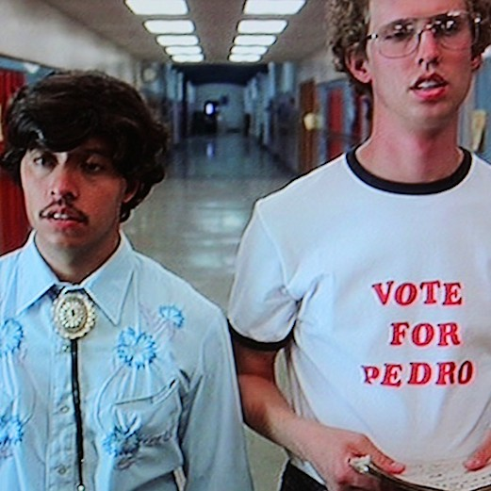
What is Parliamentary Debate?
Parliamentary debate is a persuasion contest

Slide 4
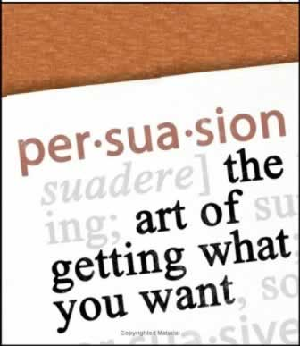
What is Persuasion?
Skill not a talent
Studied & taught effectively
> 2000 years
Anyone can learn
Secret to winning parliamentary debates
Gives ordinary people power to change the world through the actions of others

Slide 5
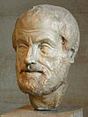
Elements of Persuasion
Ethos – appeal based on who you are as a person/speaker
Pathos – appeal based on shared emotions
Logos – appeal based on logic & evidence
“Of the modes of persuasion furnished by the spoken word there are three kinds: Persuasion is achieved by the speaker’s personal character when the speech is so spoken as to make us think him credible… Secondly, persuasion may come through the hearers, when the speech stirs their emotions… Thirdly, persuasion is effected through the speech itself when we have proved a truth or an apparent truth by
means of the persuasive
arguments suitable to the
case in question”
Aristotle – “On Rhetoric”
Notes:
And when I say it’s been studied for thousands of years, I meant it…this was written by the philosopher Aristotle about 2300 years ago…

Slide 6

How to Build: Ethos
Appearance
  Professional attire…little lawyers
  Congenial/confident body language
  Put together/care about the impression you make
Knowledge
  Access to relevant facts
  Educated vocabulary
  Compelling big picture narrative
Advocacy
  Representing concerns of a larger group
  Speaking for more than just your team
  NOT just a petty argument between students
Notes:
This is about who the judge thinks you are, so who does the judge want you to be?

Slide 7


How to Build: Pathos
Pathos Analysis
  What shared concern prompts the motion?
  If you care about “_________”, you should care about the outcome of today’s debate
  If you care about “_________”, we will show you why you should affirm/negate the motion
Make It Personal
  Tell a story about real people
  Reference real people relevant to your judge…your sons & daughters, sisters & brothers, friends & neighbors
Guided Visualization
  Imagine a world where…
  Our World/Their World
Notes:
Pathos is an appeal to emotion…designed to show that we care about the same things
So here’s a question: why are your judges spending their time at a debate tournament? What do they care about?? Who do they care about?

Slide 8
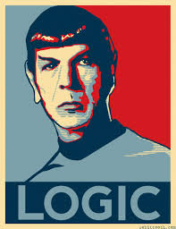
How to Build: Logos
Framework
  How to approach the question asked by the motion?
  Is it a question of values, rights, military strategy, economic benefit or ???
Complete Arguments (ARE)
  Assertion
  Reasoning
  Evidence
Direct Clash
  Identify each of the opponent’s major arguments
  Address each argument individually (or group them)
  Show why each argument is incomplete, built on faulty logic or is disproved by counter-evidence

Slide 9

Persuasion Formula
Ethos + Pathos + Logos = Persuasion = Power = Winning Parli Debate
Notes:
Here’s a hard lesson I learned in business & in school after debate…being right is good, but it is not sufficient to persuade people. It’s more important to be preferred than to be right.
To become a championship parliamentary debater, you need to work on all 3 elements of persuasion. Anything less is…well, less.
Question: How much of the last U.S. presidential election was won by ethos, pathos & logos?

Slide 10
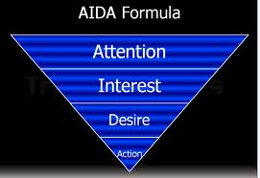
Models of Persuasion – Sales & Marketing
WIFM
  What’s in it for me?
AIDA
  Attention, Interest, Desire, Action
Target Marketing
  Who is your target audience?
  What do you want them to think, do or feel?
  What concerns drive their decision making?
  How does your proposal address their concerns?

Slide 11
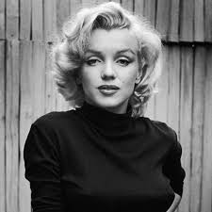
Persuasion Model: Monroe’s Motivated Sequence
Attention – Get the audience to listen
Need – Get the audience to feel a need or want
Satisfaction – Tell the audience how to fill the need or want
Visualization – Get the audience to see the benefits of your solution
Action – Get the audience to take action

Slide 12
Persuasion Model: Parliamentary Debate
See the rest
of camp!

Slide 13
Conclusion: The Power of Persuasion
Parliamentary debate is a persuasion contest
Persuasion is a skill you can develop & master
  Ethos
  Pathos
  Logos
Persuasion opens doors in debate & in life

